Slide 1
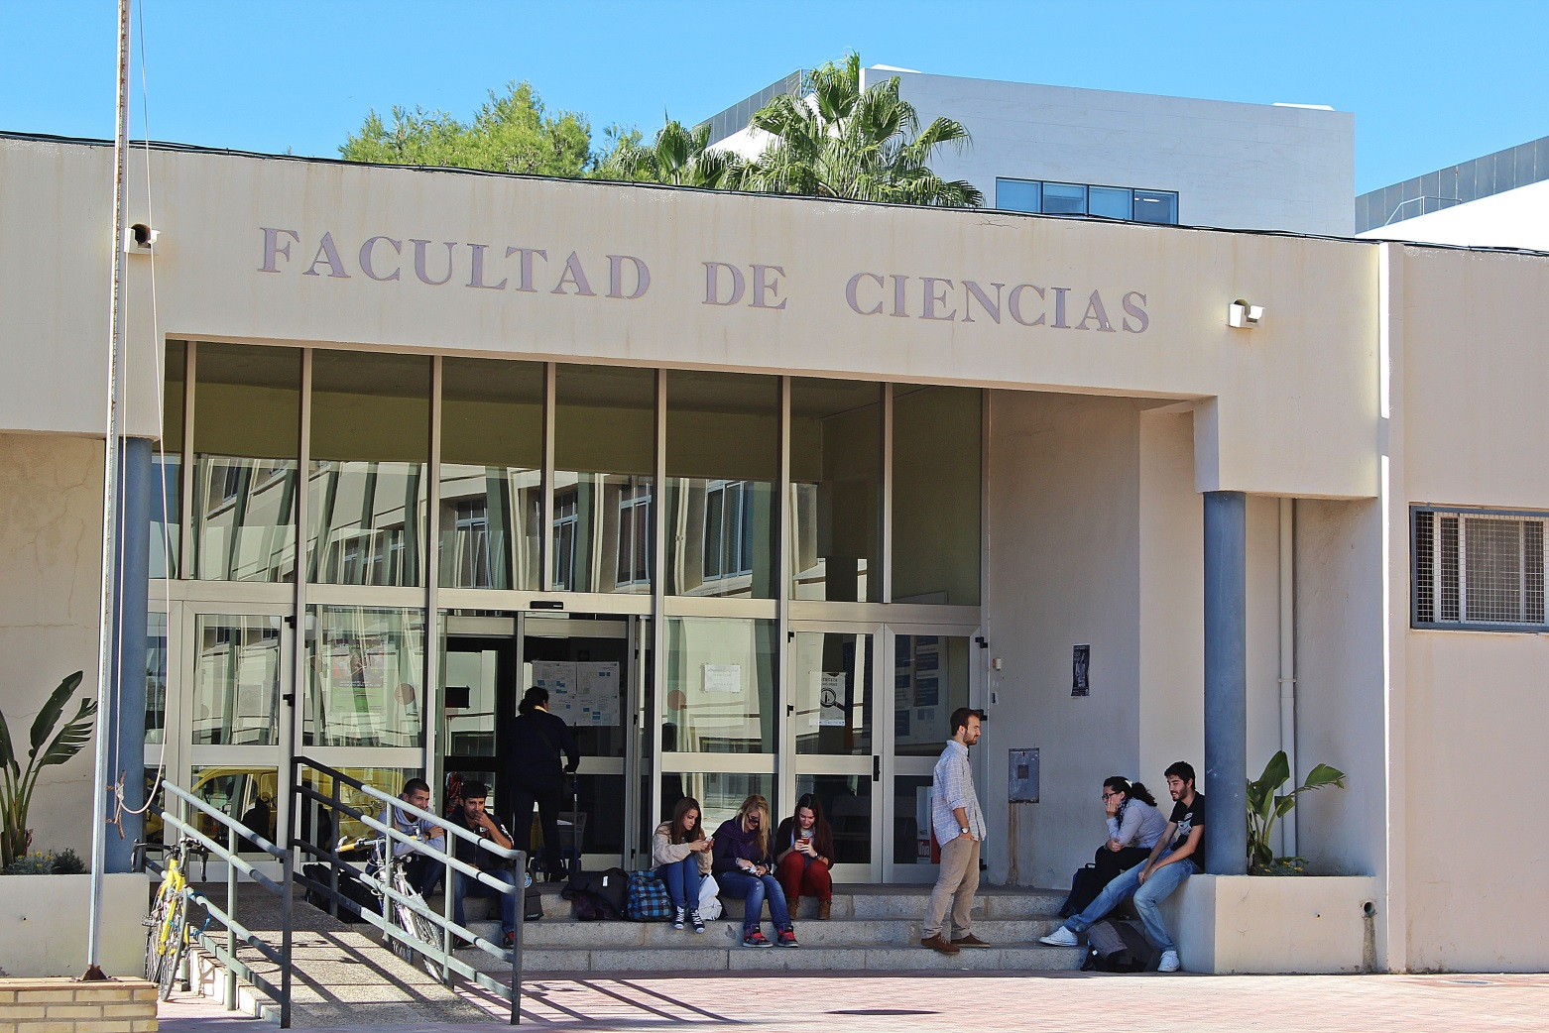
Bienvenidos - Welcome
FACULTY OF SCIENCES. UNIVERSITY OF CADIZ

Slide 2
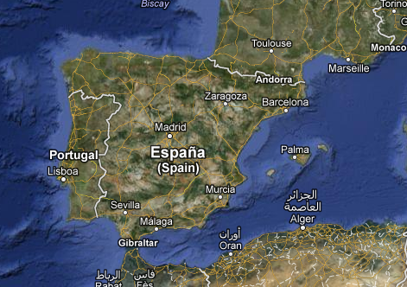
LOCALIZATION
Cádiz

Slide 3
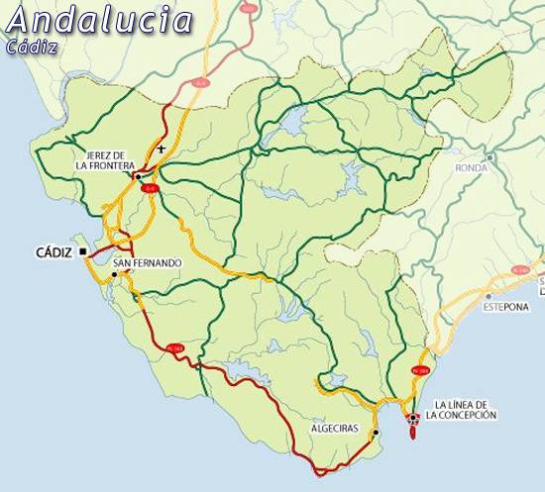
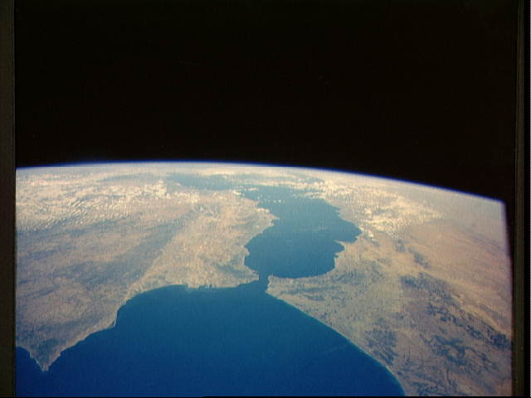
Cádiz University
4 Campus: Algeciras, Cádiz, Jerez, Puerto Real
16 Schools
45 Departments
ca. 22.000 students
Jerez Campus
Puerto Real Campus
Cadiz Campus
Algeciras Campus

Slide 4
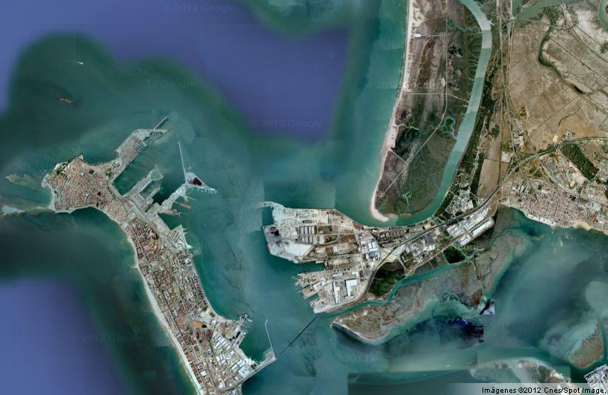
Faculty of Sciences
www.uca.es/ciencias
Puerto Real Campus
LOCALIZATION
https://youtu.be/GFtuSRnlUbs

Slide 5
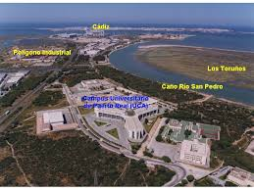
Faculty of Sciences
www.uca.es/ciencias
Puerto Real Campus
LOCALIZATION

Slide 6
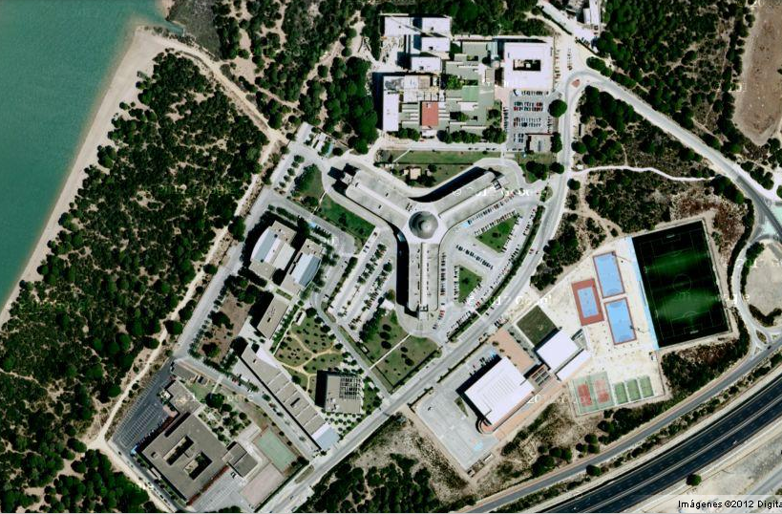
Faculty of Sciences
SCIENCE FACULTY
www.uca.es/ciencias
Puerto Real Campus
LOCALIZATION

Slide 7
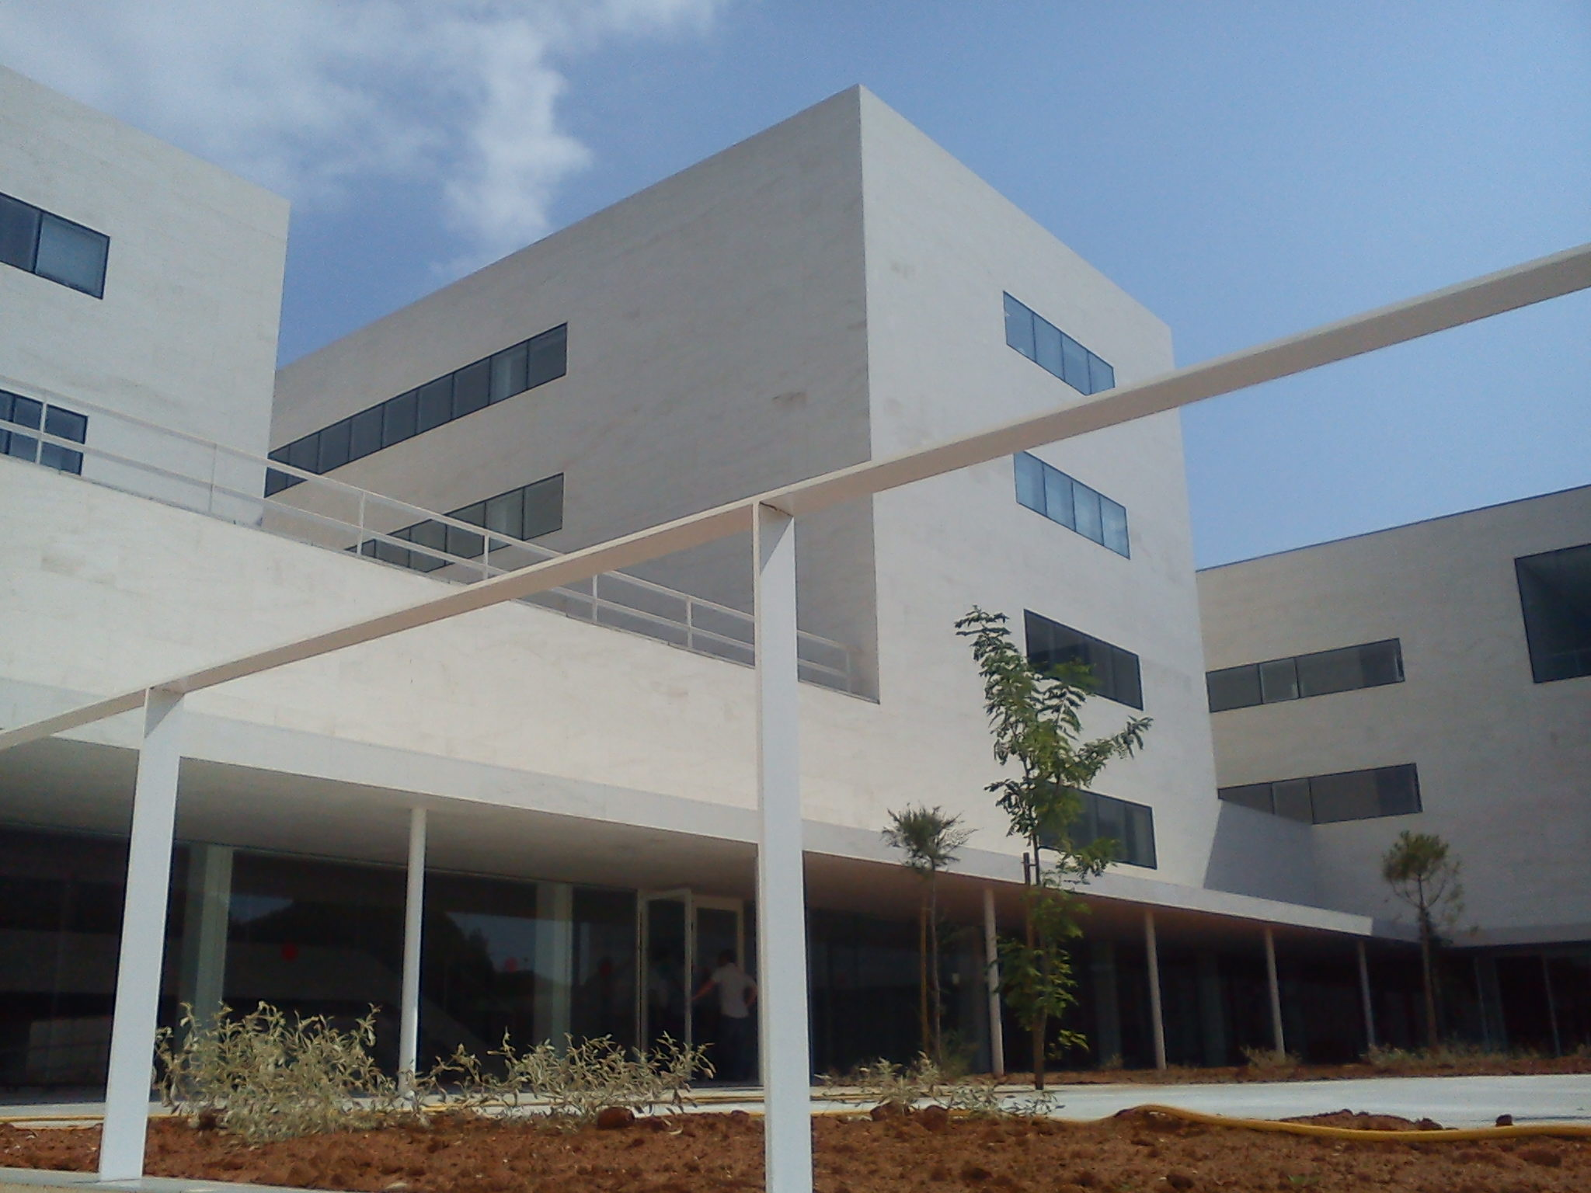
Faculty of Sciences
http://ciencias.uca.es
ACADEMIC TEAM AND STUDENTS
215 Teachers/Researchers
70 Administration /Service
More than 1200 students
New Facilities

Slide 8
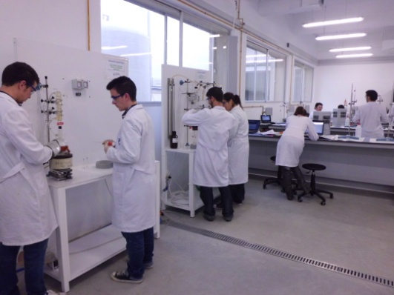
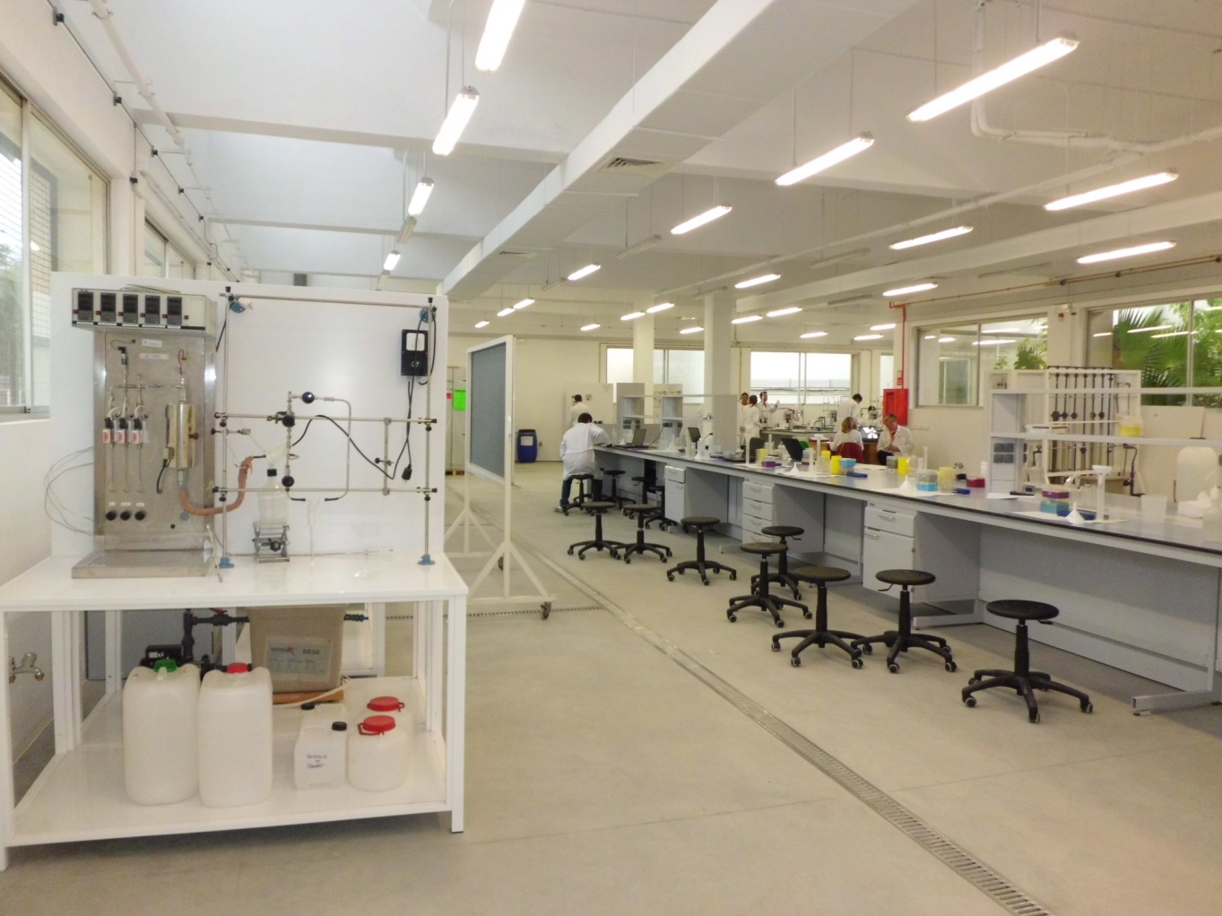
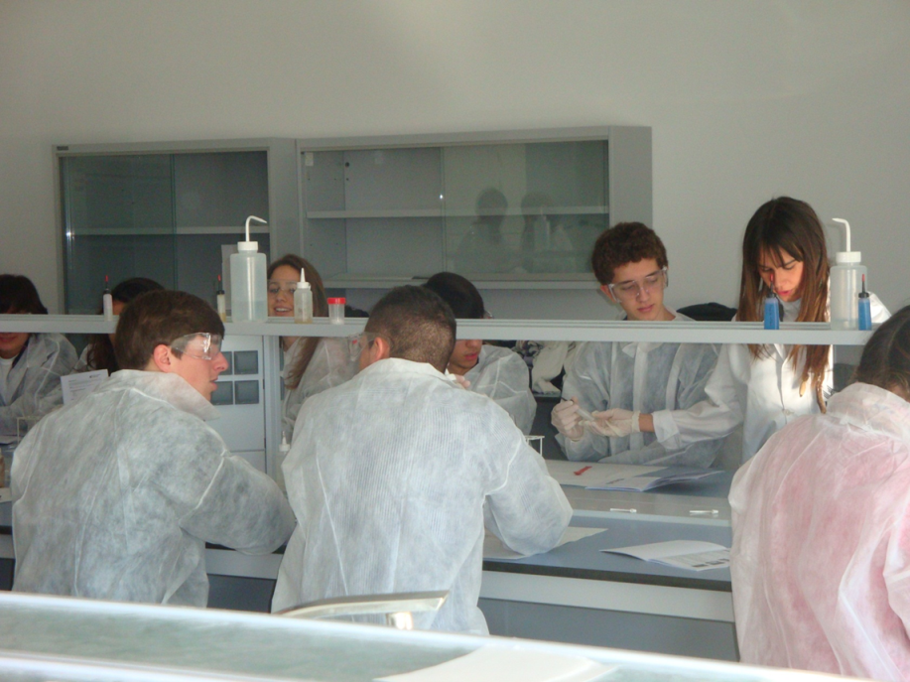
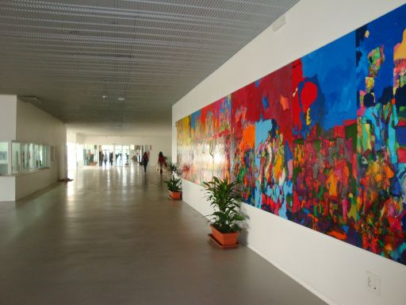
Faculty of Sciences
New Facilities

Slide 9
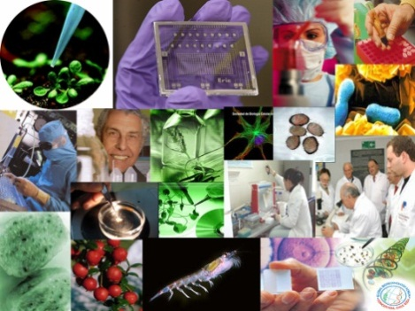
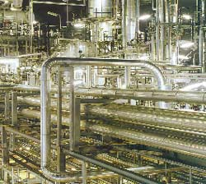
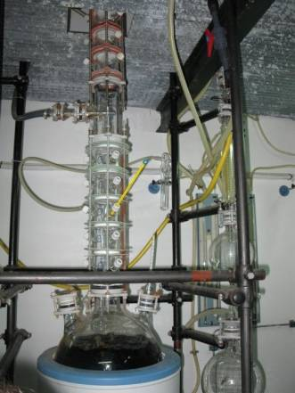
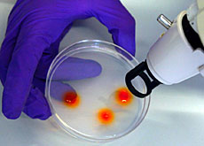
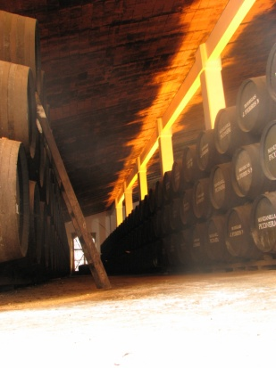
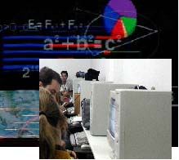
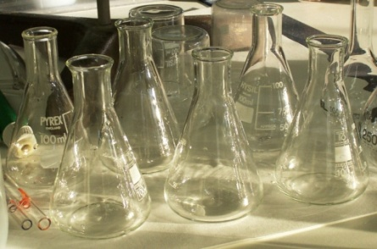
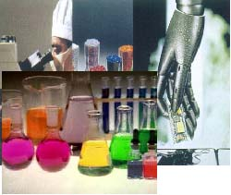
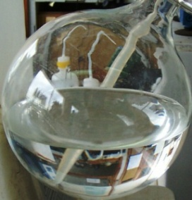
Faculty of Sciences. BsC degrees
CHEMICAL ENGINEERING
BIOTECHNOLOGY
MATHS
OENOLOGY
CHEMISTRY

Slide 10
General Degree Structure
Faculty of Sciences
4 years (8 semesters)
30 credits/ semester
240 credits/ degree
Starting academic year
1st semester (End September-October)
2nd semester (February)

Slide 11
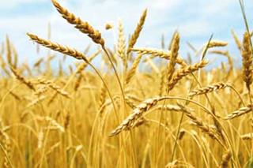
Faculty of Sciences
Interuniversity Master in Agrifood
University of Cádiz and University of Córdoba
Master Coordinator: Prof. Dr. Ana Concepción Jiménez Cantizano
University of Cádiz
Duration: 1 academic year (60 ECTS)
e-mail: master.agro@uca.es
https://posgrado.uca.es/master/agro

Slide 12
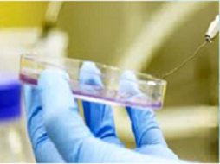
Faculty of Sciences
Master in Biotechnology
University of Cádiz
Master Coordinator: Prof. Dr. Carlos Garrido Crespo
Duration: 1 academic year (60 ECTS)
e-mail: master.biotecnología@uca.es
https://posgrado.uca.es/master/biotecnologia?curso=2018/19

Slide 13
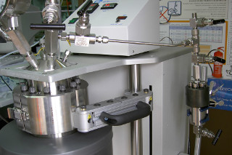
Faculty of Sciences
Interuniversity Master in Chemical Engineering
University of Cádiz, University of Almería and University of Málaga
Master Coordinator: Prof. Dr. Ana Blandino Garrido - University of Cádiz
Duration: 2 academic year (90 ECTS)
e-mail: master.ingenieriaquimica@uca.es
https://posgrado.uca.es/master/ingenieriaquimica

Slide 14
Faculty of Sciences
Master in Medical Chemistry
University of Cádiz
Master Coordinator: Prof. Dr. Isidro González Collado
Duration: 1 academic year (60 ECTS)
e-mail: master.quimicamedica@uca.es
https://oficinadeposgrado.uca.es/informacion-basica-masteres-oficiales/master-universitario-en-quimica-medica-0272/

Slide 15
Faculty of Sciences
Master in Nanoscience and Material Technologies
University of Cádiz
Master Coordinator: Prof. Dr. José María Rodríguez Izquierdo
Duration: 1 academic year (60 ECTS)
e-mail: master.nanociencia@uca.es
https://oficinadeposgrado.uca.es/informacion-basica-masteres-oficiales/master-universitario-en-nanociencia-y-tecnologia-de-materiales-0271/

Slide 16
Faculty of Sciences
Interuniversity Master in Mathematics
University of Cádiz, University of Almería, University of Granada and University of Málaga
Master Coordinator: Prof. Dr. Antonio Jesús Calderón Martín
Duration: 1 academic year (60 ECTS)
e-mail: master.matematicas@uca.es
posgrado.uca.es/master/matematicas http://www.doctomat.com

Slide 17
Faculty of Marine & Environmental Sciences. BsC degrees
Environmental Sciences
Marine Sciences

Slide 18
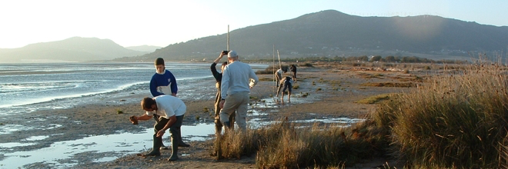
Faculty of Marine & Environmental Sciences
Conservation and Managment of the Environment
University of Cádiz
Master Coordinator: Prof. Dr. Gonzalo Muñoz Arroyo
Duration: 1 academic year (60 ECTS)
e-mail: master.conservacion@uca.es
https://ccmaryambientales.uca.es/master-en-conservacion-y-gestion-del-medio-natural

Slide 19
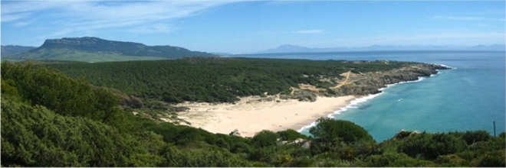
Faculty of Marine & Environmental Sciences
Integrated Coastal Management
University of Cádiz
Master Coordinator: Prof. Dr. Ana María Macías Bedoya
Duration: 1 academic year (60 ECTS)
e-mail: master.gial@uca.es
https://ccmaryambientales.uca.es/master-en-gestion-integrada-de-areas-litorales-gial/

Slide 20
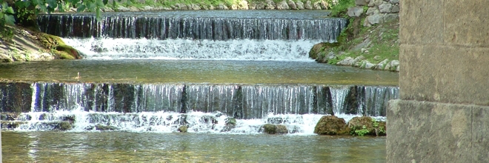
Faculty of Marine & Environmental Sciences
Integrated Water Management
University of Cádiz
Master Coordinator: Prof. Dr. Enrique Nebot Sanz
Duration: 1 academic year (60 ECTS)
e-mail: master.gial@uca.es
https://ccmaryambientales.uca.es/master-en-gestion-integral-del-agua/

Slide 21
Faculty of Sciences
PhD programs
BIOMOLECULES
AGRIFOOD RESOURCES
MARINE RESOURCES
NANOSCIENCES & NANOTECHNOLOGY
FABRICATION, MATERIALS & ENVIRONMENTAL ENGINEERING
MARINE SCIENES & TECHNOLOGIES
MARINE MANAGEMENT AND CONSERVATION
MATHEMATICS
e-mail: juancarlos.galindo@uca.es

Slide 22
Faculty of Sciences
Research Institutes on Campus:
RESEARCH INSTITUTES
Electron Microscopy and Materials Sciences
Marine Sciences Research Institute
Viticulture & Agrifood Research Institute
Research Institute in Biomedicine
Research Institute in Biomolecules

Slide 23
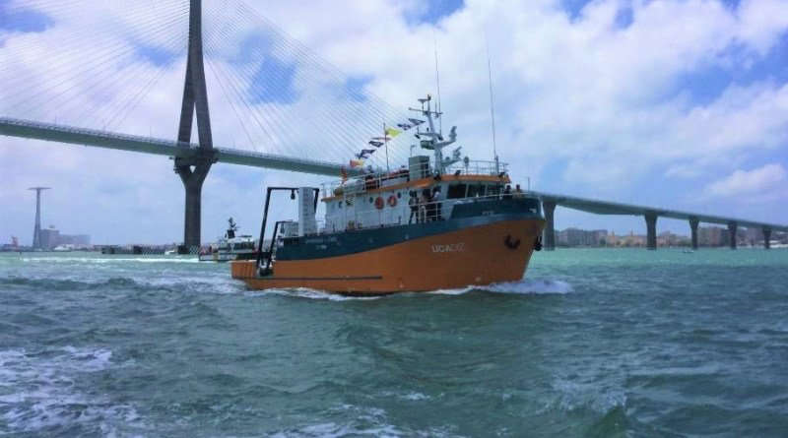
University of Cadiz
Only University in Spain with an oceanographic vessel:
Laboratory classes
Research campaigns
International Summer School
Subaquatic archaeology

Slide 24
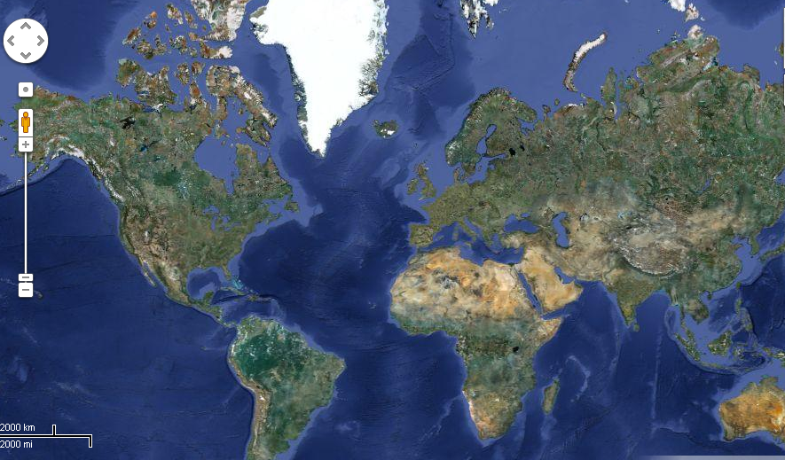
Faculty of Sciences
Mobility Programs
ERASMUS
NSF Program
KA107
KA103
AULA DEL ESTRECHO
Visiting Students
DOCTORADO IBEROAMERICANO
Becas UCA-Internacional

Slide 25
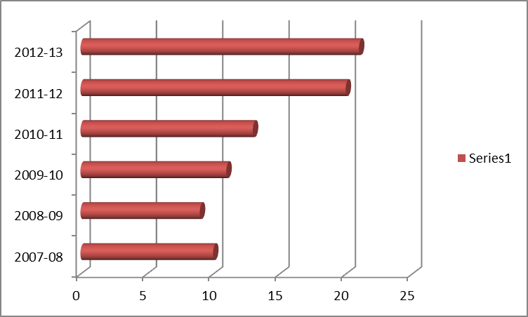
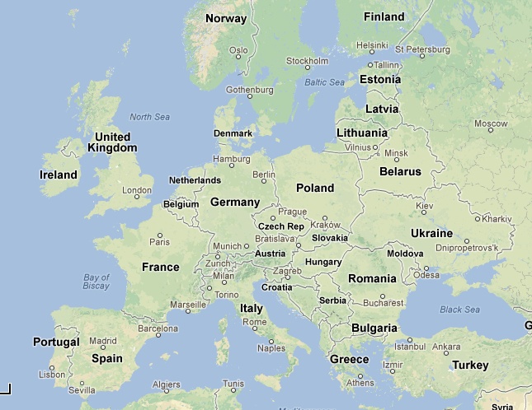
Faculty of Sciences
http://ciencias.uca.es/Movilidad/Movilidad
Mobility Programs
ERASMUS
Russia
Ciencias sin Fronteras

Slide 26
Faculty of Sciences
Mobility Programs
2008-2012 (15 students)
CUBA (11 students)
Universidad de Santa Clara-Las Villas (1)
Guillermo Universidad de Caldas – EAFIT, Cuba (1)
CUJAE – Cuba (1)
Universidad de La Habana – Cuba (6)
Universidad de Oriente -- PhD 25 Noviembre 2011
Universidad Central Marta Abreu-- PhD 17 Junio 2011
COLOMBIA (1 student)
Matilde Universidad del Norte
PERÚ (2 students)
+Universidad Católica de Santa María (1)
+Roger Univ. Nacional Mayor de
San Marcos (1)
ARGENTINA (1 student)
+Ariel Universidad de Buenos Aires

Slide 27
Faculty of Sciences
Mobility Programs
Iberoamerican Doctoral Program in Sciences
(3rd edition) Colombia 2015-2019
15 students (nowadays)
6 month in Cádiz + 6 Month in Colombia
(3 years+1)
Participants:
University of Santiago de Cali
University of Simón Bolívar
University of La Costa
University of Atlántico

Slide 28
Faculty of Sciences
Mobility Programs
NSF iREU: a Cooperative International Undergraduate Research Program at the University of Cádiz
(summer international Research Experience for Undergraduates)
Pilot program (2008) 2 students
Inaugural Year (2009) 8 students (NSF-sponsored)
Year 2 (2010) 8 students (NSF-sponsored) +1 student (independent funds)
Year 3(2011) 8 students (NSF–sponsored) + 2 students (independent funds)

Slide 29
Faculty of Sciences
Mobility Programs
Programs for trainship student:
University of Tennessee at Chattanooga
PIMA program

Slide 30
Faculty of Sciences
Analytical Chemistry
Organic Chemistry
Science of the Earth
Physics: Condensed matter
Physical Chemistry
Science Faculty
9 Departments
Maths
Material Science and Inorganic Chemistry
Statistics and Operative Research
Chemical Enginnering and Food Technology

Slide 31
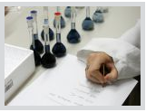
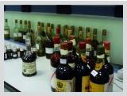
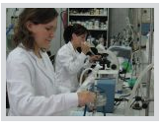
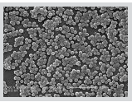
35 Research Groups
Faculty of Sciences
AGR-122 | Analytic Chemistry of Wine, Wine Products and Agriffood
AGR-179 | Physical Chemistry, Spectroscopy
AGR-209 | Food Engineering and Technology (ITA)
CTS-569 | The Study of Human Autoantigens
CTS-579 | Molecular Analysis of Centromeric Antigens in Human Chromosomes
BIO-219 | Applied Microbiology and Molecular Genetics
RNM-114 | Characterisation of Materials
RNM-144 | Oceanography and Coastal Contamination
RNM-236 | Marine Geochemistry
RNM-314 | Geodesy and Geophysics in Cadiz
RNM-328 | Coastal and Marine Geology and Geophysics
TEP-105 | Biological and Enzymatic Reactors
TEP-109 | Surface Activity and Renewable Energy Resources
TEP-115 | Processing of New Materials Using Sol-Gel
TEP-120 | Science and Engineering of Materials
TEP-128 | Analysis and Design of Processes with Supercritical Fluids
TIC-145 | Intelligent Computational Systems

Slide 32
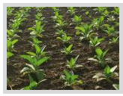
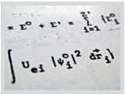
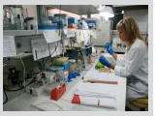
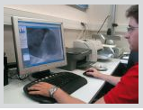
35 Research Groups
Faculty of Sciences
FQM-110 | Chemistry of Solids and Catalysis
FQM-137 | Stability and Mechanism of Inorganic Reactions
FQM-154 | Physical Properties of Amorphous Solids
FQM-166 | Simulation, Characterisation and Evolution of Materials
FQM-169 | Isolation, Structural Determination and Synthesis of Natural Products
FQM-188 | Coordination Chemistry and Organometallics
FQM-201 | Bifurcation Theory and Dynamical Systems
FQM-249 | Instrumentation and Environmental Sciences
FQM-257 | Geometry, Operators and Series in a Banach Space
FQM-265 | Theoretical Calculation of Molecular Properties
FQM-270 | TeLoYDisRen Research Group
FQM-286 | Allelopathy in Higher Plants and Microorganisms
FQM-295 | Biosysnthetic Design of Fungicides
FQM-298 | Rings Associated with Quantum Models
FQM-315 | Theoretical and Numerical Analysis of Models Arising in Experimental Sciences
FQM-334 | Structure and Chemistry of Nanomaterials
FQM-335 | Applied Magnetism and Optics
FQM-355 | Optimisation of Resources, Statistics, Transport and Logistics (OREL)

Slide 33
